Slide 1
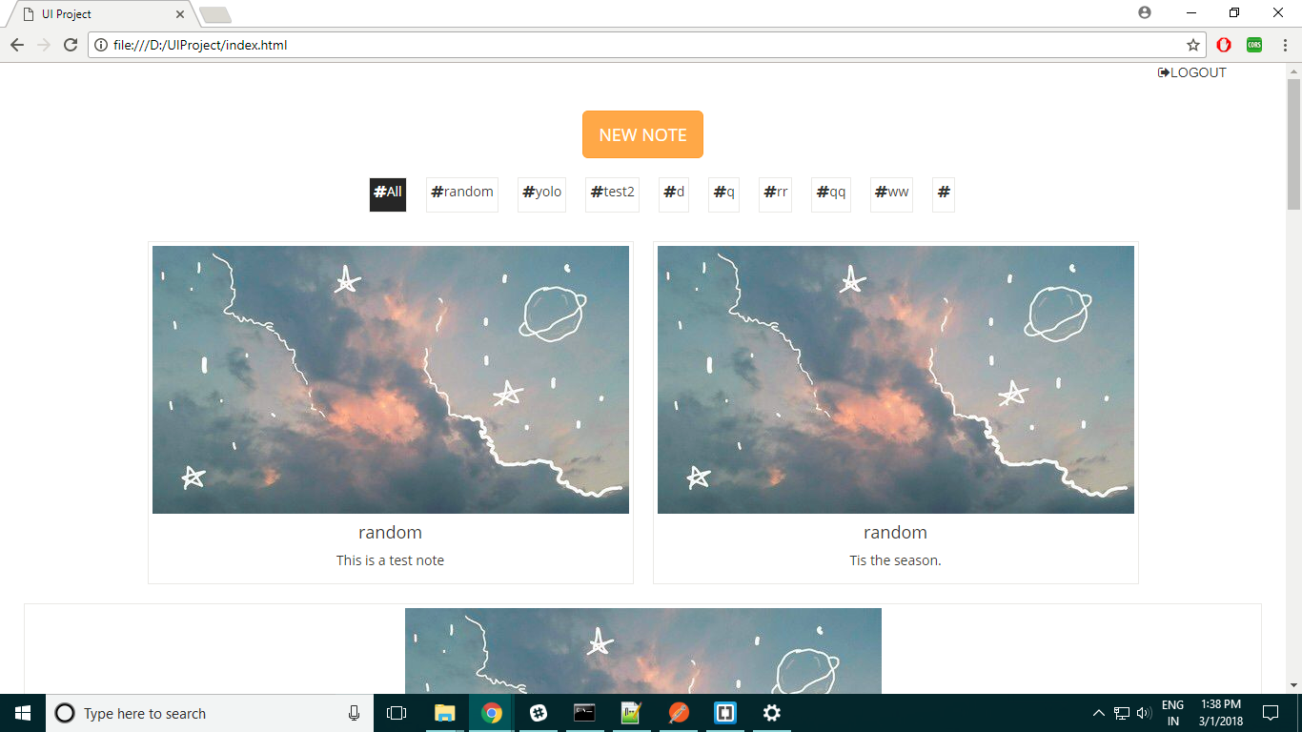
DEMO FOR UI PROJECT
- Aditya Aggarwal

Slide 2
BUSINESS REQUIREMENT
Very helpful for integration with all code sharing platforms and other general task management purposes.
Github
Asana
Slack
Mail Box
Argil DX* (In house notes building tool in the near future if possible) – Everybody in the office (from interns to HR to MD) can use this tool for day to day management of tasks

Slide 3
APPROACH TAKEN
USER INTERFACE:
Static Elements- HTML, SASS, Bootstrap
Dynamic Rendering- Vanilla JS, JQuery, Moustache JS
BACKEND:
API Hits: ECMA 6 JavaScript Fetch Library (Promises)
DATABASE CRUD API:
Provided by Chitrank (Internally it uses MongoDB)

Slide 4
DATABASE DESIGN
MongoDB Collections
Users collection
Fullname
Email
Notes collection
Email
Tag
password
text

Slide 5
LIVE DEMO

Slide 6
CODE WALKTHROUGH

Slide 7
Github link: https://github.com/AggarwalAditya/Trello-Clone/

